Slide 1
IT Professional Environment: Law, Ethics and Privacy
Week 5:
Lecturer: Dr. Farshid Keivanian

Slide 2
Definition of Computer Crime
Introduction: Computer crime refers to any illegal activity that involves a computer or networked device. Crimes can range from hacking and identity theft to spreading viruses.
Practical Scenario: Imagine a Melbourne-based online retail company discovers that its customer database has been hacked, leading to the theft of personal information.
Class Discussion Question: How should the company respond to protect its customers and prevent future incidents?
Expected Responses: Implement stronger security measures, inform affected customers, and cooperate with law enforcement.

Slide 3
Definition of Computer Crime
Multiple-Choice Question: What is a common type of computer crime?
A) Identity theft
B) Physical theft
C) Burglary
D) Vandalism
Explanation: Identity theft is a common type of computer crime where an individual's personal information is stolen and used for fraudulent purposes. This type of crime highlights the growing need for strong cybersecurity measures to protect sensitive information. Identity theft occurs when someone illegally obtains and uses another person's personal information, such as social security number or credit card details, typically for financial gain.
Example: A criminal uses stolen credit card information to make unauthorized purchases online
C) Burglary:
Explanation: Burglary is the unlawful entry into a building with the intent to commit a crime, typically theft.
Example: Breaking into a house to steal electronics.
D) Vandalism:
Explanation: Vandalism involves the deliberate destruction or damage to property.
Example: Defacing a company's website by altering its content or functionality.

Slide 4
Cyberstalking
Introduction: Cyberstalking involves using the internet or other digital means to stalk or harass an individual, group, or organization.
Practical Scenario: A Brisbane resident is receiving threatening messages through social media from an anonymous source.
Class Discussion Question: What legal steps can the individual take to protect themselves?
Responses: Report to the police, seek a restraining order, and utilize privacy settings on social media.

Slide 5
Cyberstalking
Multiple-Choice Question: Which of the following best describes cyberstalking?
A) Sending unsolicited commercial emails
B) Persistently sending threatening or harassing messages online
C) Hacking into someone's computer
D) Downloading illegal content
Explanation: Cyberstalking is a serious crime that can lead to legal actions and the need for protective measures.

Slide 6
Computer Fraud
Introduction: Computer fraud involves using computers or digital devices to deceive for personal gain.
Practical Scenario: A Sydney-based small business notices unauthorized transactions on their financial accounts.
Class Discussion Question: What steps should the business take to investigate and resolve the fraud?
Responses: Contact the bank, report the fraud to authorities, and review security protocols.

Slide 7
Computer Fraud
Multiple-Choice Question: What is an example of computer fraud?
A) Inaccurately reporting financial data
B) Manipulating data to divert funds illegally
C) Spreading viruses
D) Accessing someone’s computer without permission
Explanation: Computer fraud involves the use of a computer to manipulate data for illegal financial gain, such as diverting funds. This type of fraud can have severe financial consequences, necessitating strong safeguards to prevent it.

Slide 8
Offensive Content
Introduction: Offensive content refers to digital material that is inappropriate, harmful, or illegal, often shared or accessed online.
Practical Scenario: An educational institution in Canberra discovers that students are sharing offensive memes in a school group chat.
Class Discussion Question: What should the school’s response be to address this behavior?
Responses: Enforce school policies, educate students about online conduct, and involve parents if necessary.

Slide 9
Offensive Content
Multiple-Choice Question: Offensive content could include:
A) Educational resources
B) Harmful and inappropriate memes
C) News articles
D) None of the above
Explanation: Offensive content includes harmful and inappropriate material, such as memes that can negatively impact individuals and communities. It requires vigilance and education to manage and mitigate its effects.

Slide 10
Cyberterrorism
Introduction: Cyberterrorism involves using digital means to carry out terrorist activities, such as disrupting critical infrastructure.
Practical Scenario: A government website in Melbourne experiences a major cyberattack, leading to the shutdown of essential services.
Class Discussion Question: How should the government respond to restore services and prevent future attacks?
Responses: Implement emergency protocols, enhance cybersecurity defenses, and work with international partners.

Slide 11
Cyberterrorism
Multiple-Choice Question: Cyberterrorism primarily targets:
A) Financial institutions
B) Government and critical infrastructure
C) Social media platforms
D) Personal computers
Explanation: Cyberterrorism primarily targets government systems and critical infrastructure, posing significant threats to national security. It requires coordinated defense strategies to protect against such attacks.

Slide 12
Phishing Techniques
Introduction: Phishing involves tricking individuals into divulging personal information through deceptive emails or websites.
Practical Scenario: A Brisbane company’s employees receive an email claiming to be from the IT department asking for login credentials.
Class Discussion Question: What should employees do to verify the legitimacy of the email?
Responses: Contact the IT department directly, check for suspicious signs, and report the email.

Slide 13
Phishing Techniques
Multiple-Choice Question: Phishing attacks often involve:
A) Direct phone calls
B) Deceptive emails or fake websites
C) Physical mail
D) In-person requests
Explanation: Phishing attacks typically involve deceptive emails or fake websites designed to trick individuals into revealing sensitive information, such as passwords or credit card details. Recognizing and avoiding these attempts is essential for safeguarding personal and organizational data.

Slide 14
Spam
Introduction: Spam refers to unsolicited digital messages, often sent in bulk, that can range from advertising to malicious content.
Practical Scenario: An employee at a Sydney-based tech firm receives a flood of spam emails after registering for a conference.
Class Discussion Question: How can the firm prevent spam from affecting productivity?
Responses: Implement email filters, educate employees, and review data privacy policies.

Slide 15
Spam
Multiple-Choice Question: Which of the following is considered spam?
A) A personal email from a friend
B) A bulk email offering low-cost loans
C) An email from your manager
D) A job offer
Explanation: Spam refers to unsolicited bulk emails, often used for advertising or fraudulent purposes. These emails can be disruptive and sometimes dangerous, making effective filtering and awareness crucial to avoid potential risks.

Slide 16
Harassment
Introduction: Digital harassment involves using online platforms to intimidate or threaten someone, often repeatedly.
Practical Scenario: A Canberra-based employee reports being harassed online by a colleague after a workplace dispute.
Class Discussion Question: What actions should the employee and the company take to address this harassment?
Responses: Report the harassment to HR, document the incidents, and seek legal advice if necessary.

Slide 17
Harassment
Multiple-Choice Question: Digital harassment could involve:
A) Repeated threats or insults online
B) Sending friendly emails
C) Positive social media comments
D) Ignoring someone
Explanation: Digital harassment involves repeated threats or insults delivered through online platforms. It can lead to serious emotional and legal consequences, making it important to address such behavior promptly and effectively.

Slide 18
Recap Question
Question: How might you apply these concepts in your future careers? Discuss with a partner and design a group presentation to share your thoughts.
You can apply these concepts in your future careers by incorporating strong cybersecurity practices, recognizing and responding to digital threats, and ensuring compliance with legal and ethical standards. For example, as an IT professional in Melbourne, you might implement robust data protection strategies to prevent cyberattacks on your organization.

Slide 19
Recap Question
Follow-Up Discussion: Discuss the importance of being proactive in understanding and addressing digital security challenges. How can you ensure you are prepared for such issues in your professional life?
Being proactive in understanding and addressing digital security challenges is crucial for safeguarding your professional environment. You can prepare by staying updated on the latest security trends, regularly training on cybersecurity protocols, and fostering a culture of vigilance within your team. Engaging in continuous learning and applying best practices in your daily work will help ensure you are prepared for any digital security issues that arise.

Slide 20
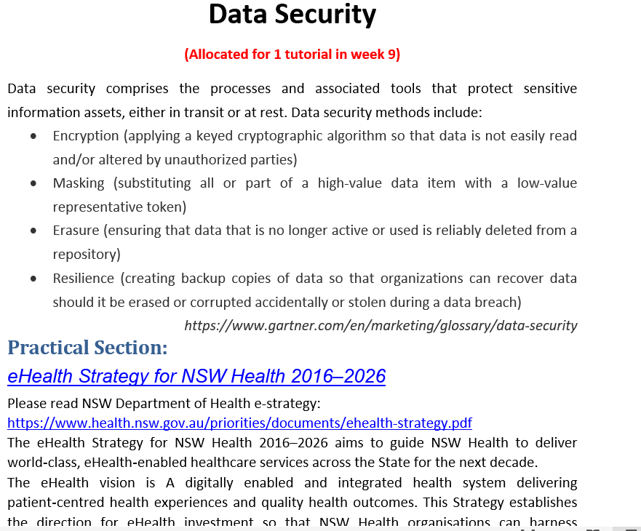
Tutorial Week 5

Slide 21
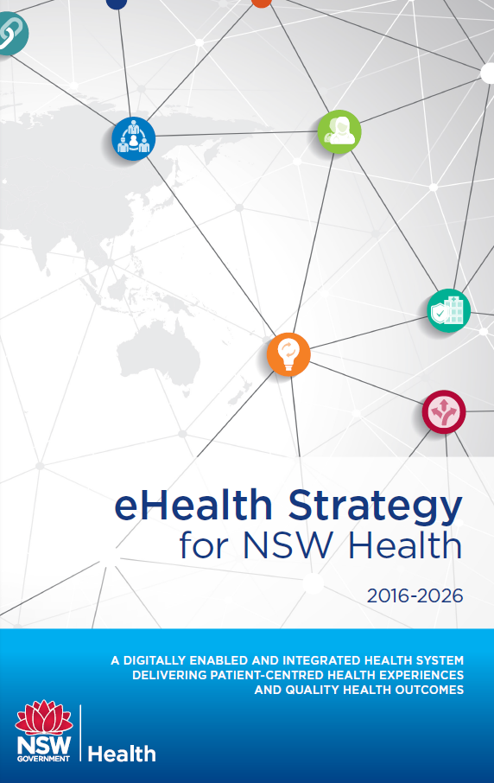
Tutorial Week 5
The e-Health study provides an in-depth look at the eHealth Strategy for NSW Health, focusing on various aspects of healthcare improvement through digital technologies. Based on the information, here’s how we might address the specific content regarding data security and practical work tasks:

Slide 22
Tutorial Week 5
Data Security Overview
Data security involves processes and tools designed to protect sensitive information, both in transit and at rest. Key methods include:
Encryption: Using cryptographic algorithms to make data unreadable to unauthorized parties.
Masking: Replacing sensitive data with a token or lower-value representation to protect the original data.
Erasure: Ensuring data that is no longer needed is securely deleted from all repositories.
Resilience: Creating backups to recover data if it is lost, corrupted, or stolen.

Slide 23
Tutorial Week 5
Practical Work: Security and Privacy Policy Development
You are expected to review lecture materials and collaborate in groups to create a security and privacy policy for the Medical Directory System. This task emphasizes applying the concepts of encryption, masking, erasure, and resilience in a real-world healthcare context, ensuring the protection of patient data and compliance with regulations.
Sample Policies for Reference:
QANTAS Privacy and Security: Qantas Privacy Policy
NSW Transport Opal Card Policy: Opal Privacy Policy
These references provide examples of how organizations manage privacy and data security, offering insights that can be adapted to the healthcare context.

